Slide 1

Accounting in Action

Slide 2
Study Objectives
Explain what is accounting? Objectives and Importance of Accounting.
Identify the users and uses of accounting.
Understand why ethics is a fundamental business concept.
Explain generally accepted accounting principles and the cost principle.
Explain the monetary unit assumption and the economic entity assumption.
State the accounting equation, and define its components.
Analyze the effects of business transactions on the accounting equation.
Understand the four financial statements and how they are prepared.
Notes:
1. On the topic, “Challenges Facing Financial Accounting,” what did the AICPA Special Committee on Financial Reporting suggest should be included in future financial statements?
Non-financial Measurements (customer satisfaction indexes, backlog information, and reject rates on goods purchases).
Forward-looking Information
Soft Assets (a company’s know-how, market dominance, marketing setup, well-trained employees, and brand image).
Timeliness (no real time financial information)

Slide 3

Accounting in Action
What is Accounting?
The Building Blocks of Accounting
The Basic Accounting Equation
Using the Basic Accounting Equation
Financial Statements
Three activities
Who uses accounting data
Ethics in financial reporting
Generally accepted accounting principles
Assumptions
Assets
Liabilities
Owner’s equity
Transaction analysis
Summary of transactions
Income statement
Owner’s equity statement
Balance sheet
Statement of cash flows
Notes:
Service Cost - Actuaries compute service cost as the present value of the new benefits earned by employees during the year. Future salary levels considered in calculation.
Interest on Liability - Interest accrues each year on the PBO just as it does on any discounted debt.
Actual Return on Plan Assets - Increase in pension funds from interest, dividends, and realized and unrealized changes in the fair market value of the plan assets.
Amortization of Unrecognized Prior Service Cost - The cost of providing retroactive benefits is allocated to pension expense in the future, specifically to the remaining service-years of the affected employees.
Gain or Loss - Volatility in pension expense can be caused by sudden and large changes in the market value of plan assets and by changes in the projected benefit obligation. Two items comprise the gain or loss:
difference between the actual return and the expected return on plan assets and,
amortization of the unrecognized net gain or loss from previous periods

Slide 4
What is Accounting?
The purpose of accounting is to:
identify, record, and communicate the economic events of an
organization to
interested users.
SO 1 Explain what accounting is.

Slide 5
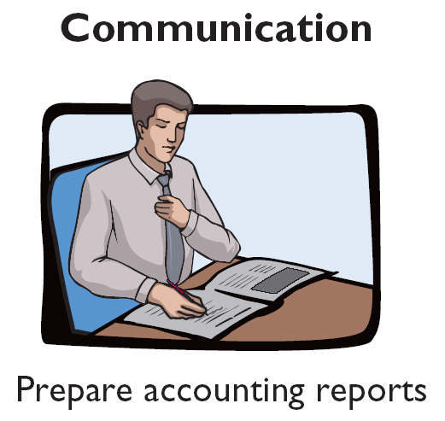
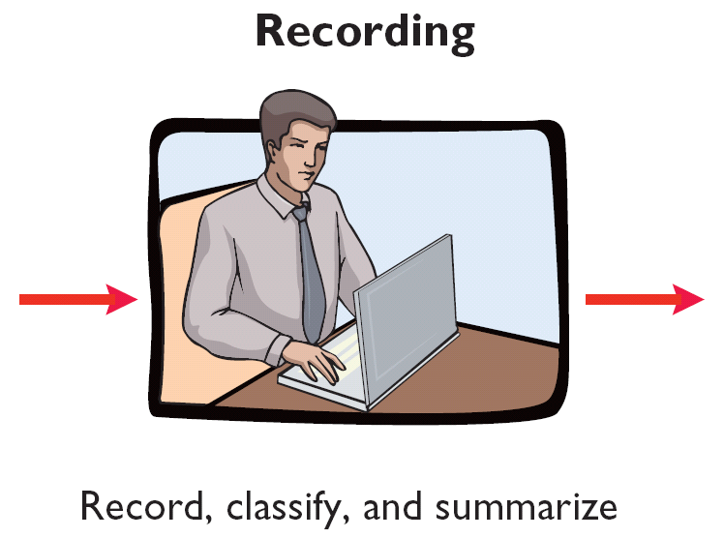
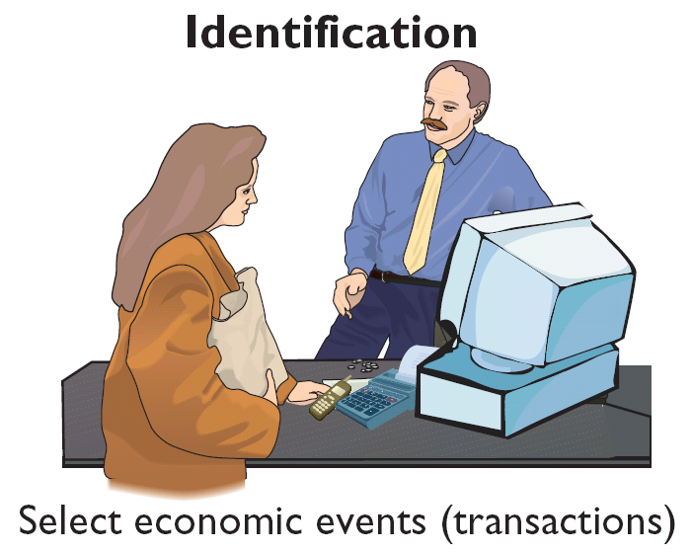
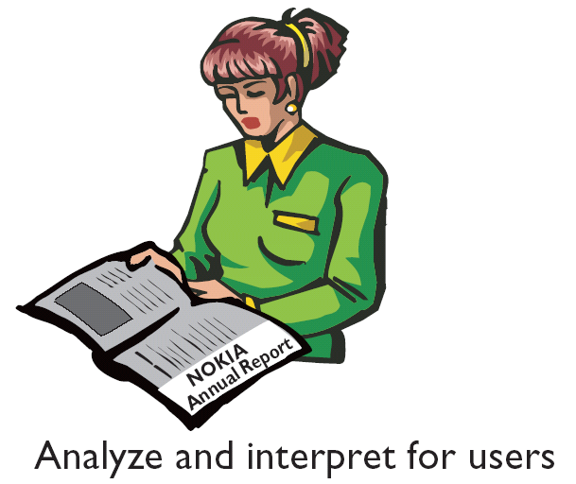
What is Accounting?
Three Activities
Illustration 1-1
Accounting process
The accounting process includes
the bookkeeping function.
SO 1 Explain what accounting is.

Slide 6
What is Accounting?
So, Accounting may be defined as,
It is a systematic process of identifying, recording, measuring, classifying, verifying, summarizing, interpreting and communicating financial information.
It reveals profit or loss for a given period, and the value and nature of a company’s assets, liabilities and owner’s equity.

Slide 7
Objectives and Importance of Accounting
To keep systematic and Permanent Record: Any business firm needs to keep systematic and permanent record of transactions. These records could be required for internal purpose, for taxation purpose or any other purpose. Accounting serves this function.
To ascertain the operational profit or loss: Accounting helps in ascertaining profit earned or loss suffered on account of carrying a business. This is done by keeping a proper record of revenues and expenses over a particular period.
To ascertain the financial position of business:
In order to know about the financial position of a business i.e., where it stands, what it owes and what it owns; preparation of balance sheet or position statement is essential, and this is done by accounting.

Slide 8
Objectives and Importance of Accounting
To know about Creditworthiness: Without proper accounting information, no investor or bank will invest/give money to the business. Past accounting records helps a great deal in providing this financial information to all investors, creditors, banks, etc.
To ensure effective use of Resources: Accounting data helps the management to analyze past performance and behavior and draw lessons as to how they could have performed better and used resources efficiently.
To facilitate in making decisions /projections: Accounting these days has taken upon itself the task of collection, analysis, and reporting of information to the required level of authority in order to facilitate in making decisions /projections.

Slide 9
What is Accounting System?
Accounting System:
It is a organized set of manual and computerized accounting methods, procedures, and controls established to gather, record, classify, analyze, summarize, interpret, and present accurate and timely financial data for management decisions.
An accounting information system (AIS) is a structure that a business uses to collect, store, manage, process, retrieve and report its financial data so that it can be used by accountants, consultants, business analysts, managers, chief financial officers (CFOs), auditors and regulatory and tax agencies.

Slide 10
Objectives of Accounting System
Without accurate accounting information it is difficult to make decision because it helps to see where we are, where we have been and trends of where we are heading. The accounting information system should be a tool that provides information that is easy to understand in the format we need.
Track spending and income: The primary objective of an accounting system is to help us track the income and spending of our company.
Reporting: Accurate reports are very important to make business decision.
Workflow: In order to allow more efficient workflow, all staff should follow the same system.
Tax Information: The system should allow to track the proper information necessary to file our taxes.

Slide 11
Who Uses Accounting Data?
Internal Users
Management
Tax Authority
Human Resources
Investors
There are two broad groups of users of financial information: internal users and external users.
Labor Unions
Finance
Creditors
Marketing
SEC
Customers
External Users
SO 2 Identify the users and uses of accounting.

Slide 12
The Building Blocks of Accounting
Ethics In Financial Reporting
Standards of conduct by which one’s actions are judged as right or wrong, honest or dishonest, fair or not fair, are Ethics.
Carrying on a business or investing money depend on accurate and dependable financial reporting.
Effective financial reporting depends on sound ethical behavior.
SO 3 Understand why ethics is a fundamental business concept.

Slide 13

The Building Blocks of Accounting
Financial Statements
Balance Sheet
Income Statement
Statement of Owner’s Equity
Statement of Cash Flows
Note Disclosure
Various users need financial information
The accounting profession has attempted to develop a set of standards that are generally accepted and universally practiced.
Generally Accepted Accounting Principles (GAAP)
SO 4 Explain generally accepted accounting principles and the cost principle.

Slide 14

The Building Blocks of Accounting
Cost Principle (Historical) – dictates that companies record assets at their cost.
Issues:
  Reported at cost when purchased and also over the time the asset is held.
  Cost easily verified, whereas market value is often subjective.
  Fair value information may be more useful.
SO 4 Explain generally accepted accounting principles and the cost principle.

Slide 15
Assumptions
Monetary Unit Assumption – include in the accounting records only transaction data that can be expressed in terms of money.
Economic Entity Assumption – requires that activities of the entity be kept separate and distinct from the activities of its owner and all other economic entities.
  Proprietorship.
  Partnership.
  Corporation.
Forms of Business Ownership
SO 5 Explain the monetary unit assumption and the economic entity assumption.

Slide 16
Forms of Business Ownership
Proprietorship
Partnership
Corporation
Generally owned by one person.
Often small service-type businesses
Owner receives any profits, suffers any losses, and is personally liable for all debts.
Owned by two or more persons.
Often retail and service-type businesses
Generally unlimited personal liability
Partnership agreement
Ownership divided into shares of stock
Separate legal entity organized under state corporation law
Limited liability
SO 5 Explain the monetary unit assumption and the economic entity assumption.
Notes:
Service Cost - Actuaries compute service cost as the present value of the new benefits earned by employees during the year. Future salary levels considered in calculation.
Interest on Liability - Interest accrues each year on the PBO just as it does on any discounted debt.
Actual Return on Plan Assets - Increase in pension funds from interest, dividends, and realized and unrealized changes in the fair market value of the plan assets.
Amortization of Unrecognized Prior Service Cost - The cost of providing retroactive benefits is allocated to pension expense in the future, specifically to the remaining service-years of the affected employees.
Gain or Loss - Volatility in pension expense can be caused by sudden and large changes in the market value of plan assets and by changes in the projected benefit obligation. Two items comprise the gain or loss:
difference between the actual return and the expected return on plan assets and,
amortization of the unrecognized net gain or loss from previous periods

Slide 17
The Basic Accounting Equation
Assets
Liabilities
Owner’s Equity
=
+
Provides the underlying framework for recording and summarizing economic events.
Assets are claimed by either creditors or owners.
Claims of creditors must be paid before ownership claims.
SO 6 State the accounting equation, and define its components.

Slide 18
The Basic Accounting Equation
Assets
Liabilities
Owner’s Equity
=
+
Provides the underlying framework for recording and summarizing economic events.
Assets
  Resources a business owns.
  Provide future services or benefits.
  Cash, Supplies, Equipment, etc.
SO 6 State the accounting equation, and define its components.

Slide 19
The Basic Accounting Equation
Assets
Liabilities
Owner’s Equity
=
+
Provides the underlying framework for recording and summarizing economic events.
Liabilities
  Claims against assets (debts and obligations).
  Creditors - party to whom money is owed.
  Accounts payable, Notes payable, etc.
SO 6 State the accounting equation, and define its components.

Slide 20
The Basic Accounting Equation
Assets
Liabilities
Owner’s Equity
=
+
Provides the underlying framework for recording and summarizing economic events.
Owner’s Equity
  Ownership claim on total assets.
  Referred to as residual equity.
  Capital, Drawings, etc. (Proprietorship or Partnership).
SO 6 State the accounting equation, and define its components.

Slide 21
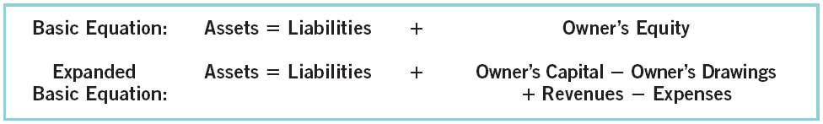
Owners’ Equity
Illustration 1-6
Revenues result from business activities entered into for the purpose of earning income.
Common sources of revenue are: sales, fees, services, commissions, interest, dividends, and rent.
SO 6 State the accounting equation, and define its components.

Slide 22
Owners’ Equity
Illustration 1-6
Expenses are the cost of assets consumed or services used in the process of earning revenue.
Common expenses are: salaries expense, rent expense, utilities expense, tax expense, etc.
SO 6 State the accounting equation, and define its components.

Slide 23
Using The Basic Accounting Equation
Transactions are a business’s economic events recorded by accountants.
  May be external or internal.
  Not all activities represent transactions.
  Each transaction has a dual effect on the accounting equation.
SO 7 Analyze the effects of business transactions on the accounting equation.

Slide 24
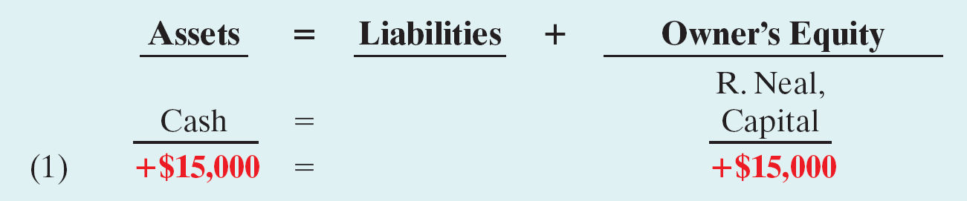
Transactions Analysis
Transaction (1). Investment By Owner. Ray Neal decides to open a computer programming service which he names Softbyte. On September 1, 2010, he invests $15,000 cash in the. The effect of this transaction on the basic equation is:
SO 7 Analyze the effects of business transactions on the accounting equation.

Slide 25
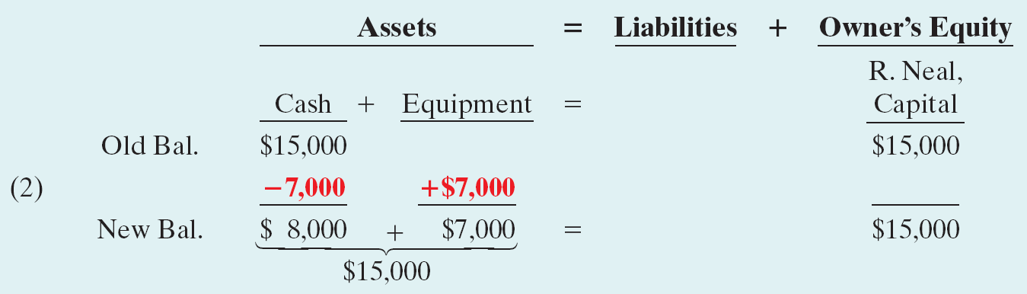
Transactions Analysis
Transaction (2). Purchase of Equipment for Cash. Softbyte purchases computer equipment for $7,000 cash.
SO 7 Analyze the effects of business transactions on the accounting equation.

Slide 26
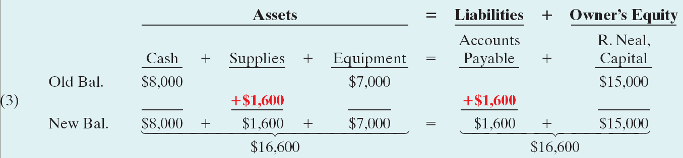
Transactions Analysis
Transaction (3). Purchase of Supplies on Credit. Softbyte purchases for $1,600 from Acme Supply Company computer paper and other supplies expected to last several months.
SO 7 Analyze the effects of business transactions on the accounting equation.

Slide 27
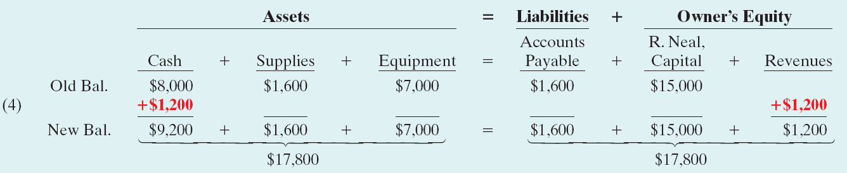
Transactions Analysis
Transaction (4). Services Provided for Cash. Softbyte receives $1,200 cash from customers for programming services it has provided.
SO 7 Analyze the effects of business transactions on the accounting equation.

Slide 28
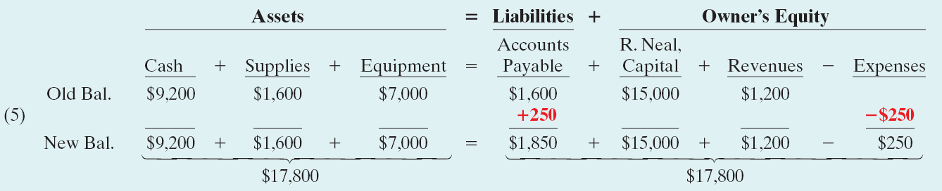
Transactions Analysis
Transaction (5). Purchase of Advertising on Credit. Softbyte receives a bill for $250 from the Daily News for advertising but postpones payment until a later date.
SO 7 Analyze the effects of business transactions on the accounting equation.

Slide 29
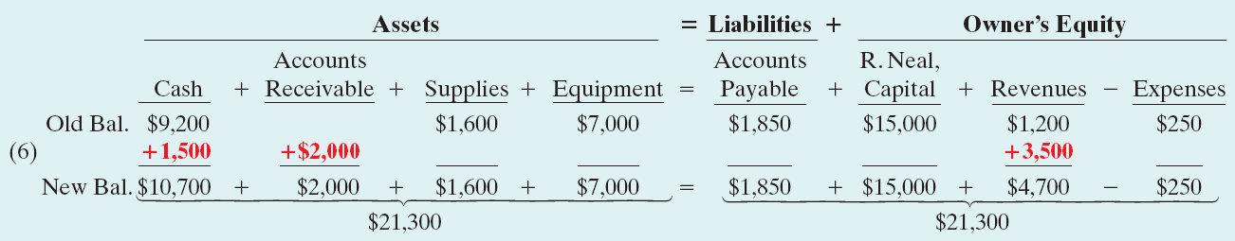
Transactions Analysis
Transaction (6). Services Provided for Cash and Credit. Softbyte provides $3,500 of programming services for customers. The company receives cash of $1,500 from customers, and it bills the balance of $2,000 on account.
SO 7 Analyze the effects of business transactions on the accounting equation.

Slide 30
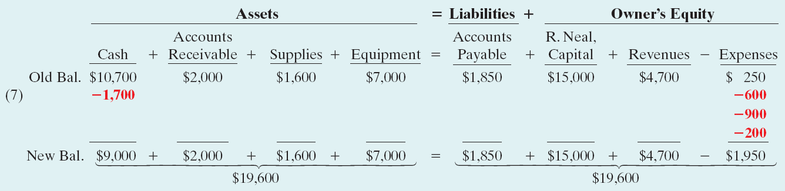
Transactions Analysis
Transaction (7). Payment of Expenses. Softbyte pays the following Expenses in cash for September: store rent $600, salaries of employees $900, and utilities $200.
SO 7 Analyze the effects of business transactions on the accounting equation.

Slide 31
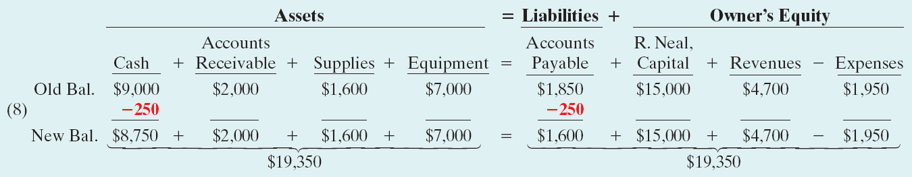
Transactions Analysis
Transaction (8). Payment of Accounts Payable. Softbyte pays its $250 Daily News bill in cash.
SO 7 Analyze the effects of business transactions on the accounting equation.

Slide 32
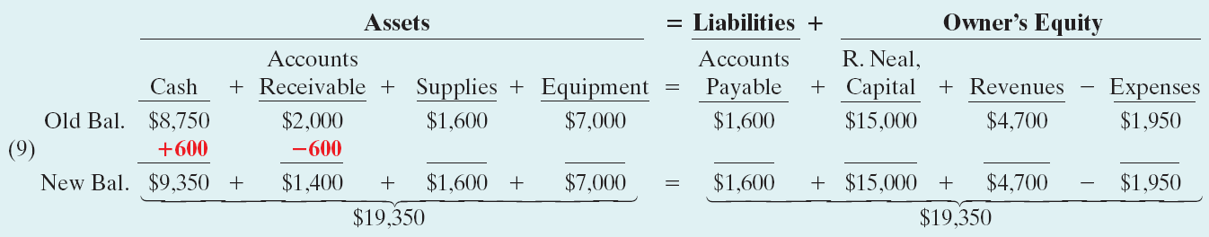
Transactions Analysis
Transaction (9). Receipt of Cash on Account. Softbyte receives $600 in cash from customers who had been billed for services [in Transaction (6)].
SO 7 Analyze the effects of business transactions on the accounting equation.

Slide 33
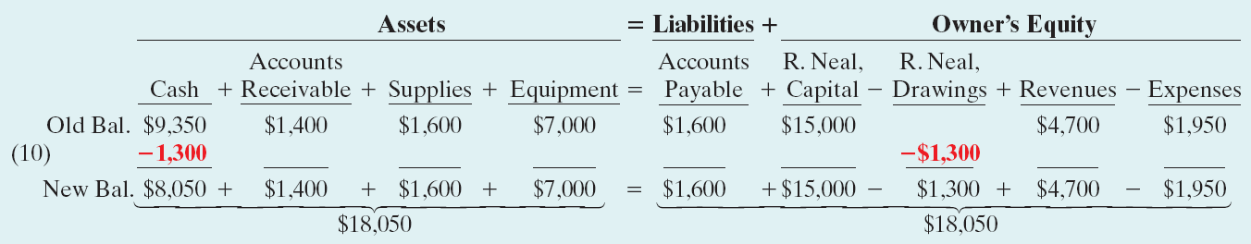
Transactions Analysis
Transaction (10). Withdrawal of Cash by Owner. Ray Neal withdraws $1,300 in cash from the business for his personal use.
SO 7 Analyze the effects of business transactions on the accounting equation.

Slide 34
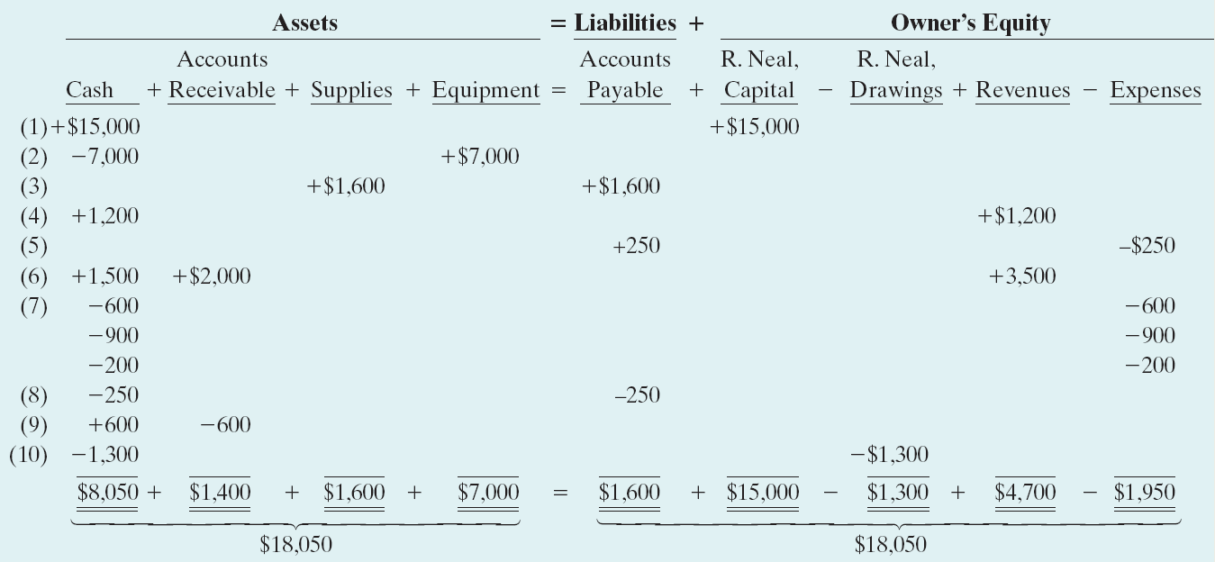
Transactions Analysis
Illustration 1-8
Tabular summary of
Softbyte transactions
Summary of Transactions
SO 7 Analyze the effects of business transactions on the accounting equation.

Slide 35
Financial Statements
Companies prepare four financial statements from the summarized accounting data:
Income Statement
Owner’s Equity Statement
Balance Sheet
Statement of Cash Flows
SO 8 Understand the four financial statements and how they are prepared.

Slide 36
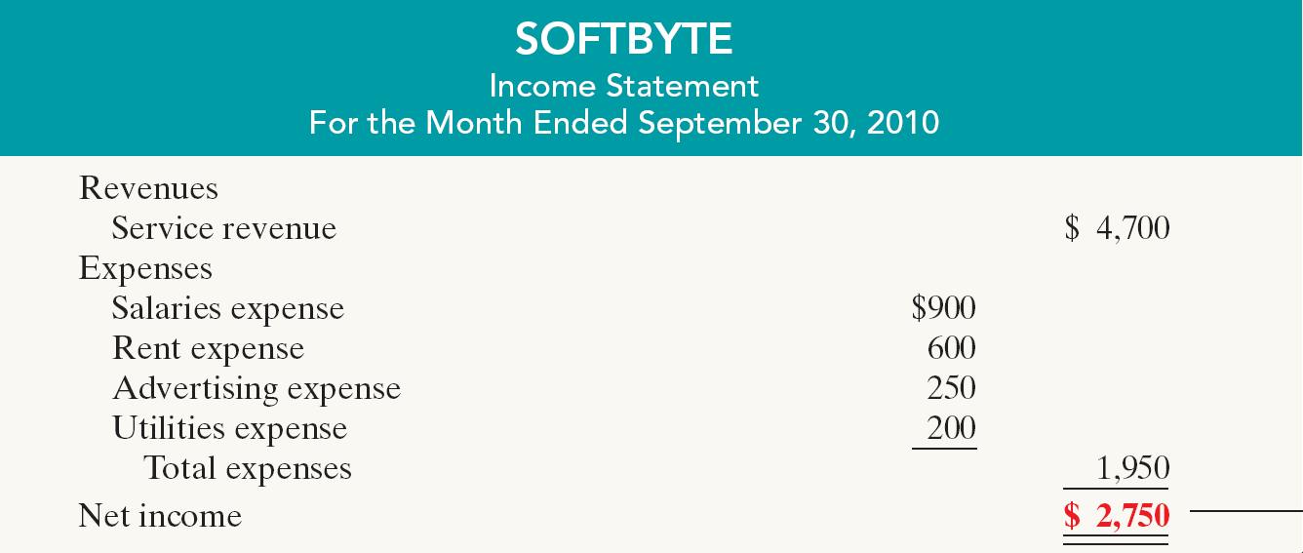
Financial Statements
Income Statement
Reports the revenues and expenses for a specific period of time.
Net income – revenues exceed expenses.
Net loss – expenses exceed revenues.
Illustration 1-9
Financial statements and
their interrelationships
SO 8 Understand the four financial statements and how they are prepared.

Slide 37
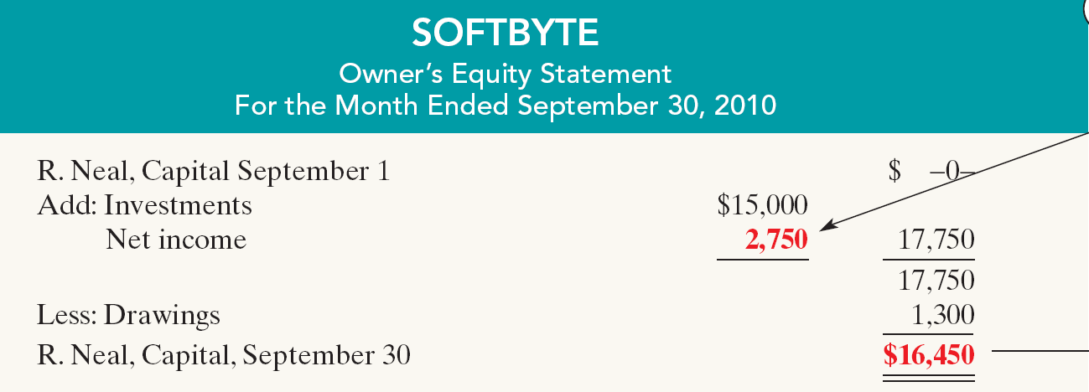
Financial Statements
Owner’s Equity Statement
Statement indicates the reasons why owner’s equity has increased or decreased during the period.
Illustration 1-9
Financial statements and
their interrelationships
SO 8 Understand the four financial statements and how they are prepared.

Slide 38
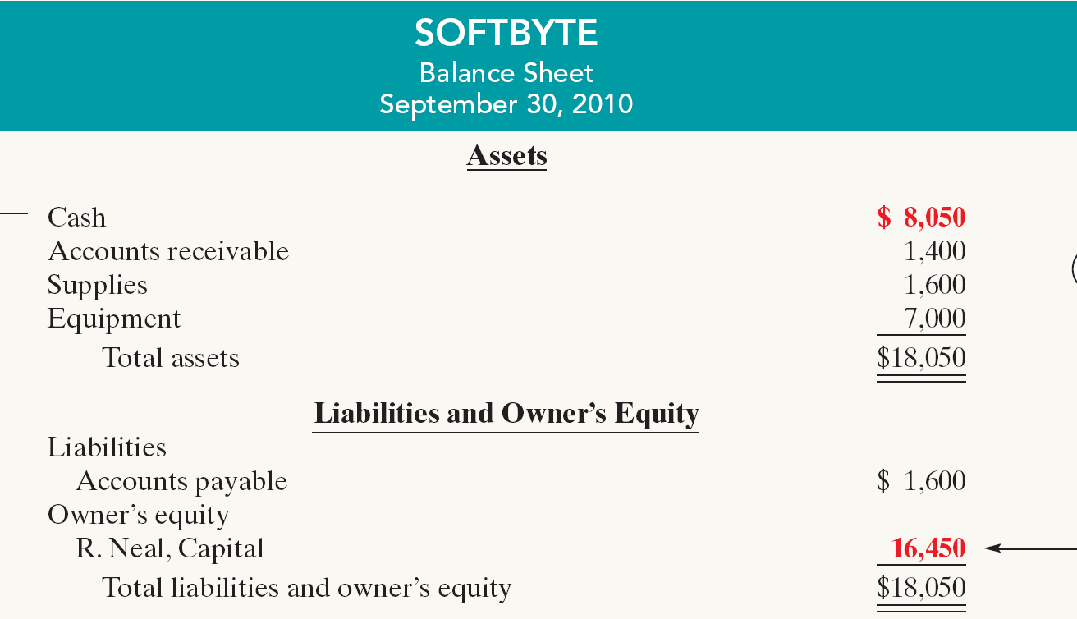
Financial Statements
Balance Sheet
Illustration 1-9
Financial statements and
their interrelationships
SO 8 Understand the four financial statements and how they are prepared.

